Slide 1
FINAL YEAR PROJECT PRESENTATION 23B
ONLINE HOSPITAL BILLING SYSTEM
By
SULAIMAN FAIZ MUHAMMAD
BU/2OC/IT/4665
Supervisor: Mr. USMAN ABUBAKAR

Slide 2
INTRODUCTION
The Online Hospital Billing System is an online storage system that stores, manages, and maintains client’s bills in a centralized database. It is designed to curb challenges faced by patients. Online Hospital Billing System proves to enhance patients’ payment.
The aim of this project is to develop a comprehensive online hospital billing system that will enable patients to pay their medical bills online either by card or an e-wallet and help hospitals manage their billing process in an efficient and streamlined manner. The system will include features such as secure payment processing, automatic billing, and real-time updates on payments and billing status.

Slide 3
PROBLEM STATEMENT
Manual Record-Keeping Issues
Clarity and Damage Risks
Importance of Proper Record Management
Significance of Hospital Records
Limitations of Manual Systems
Natural Disaster Vulnerability

Slide 4
OBJECTIVES
The objectives of this system are as follows:
1. To assess the major features of the various hospital billing system.
2. To examine the problems associated with the various hospital billing system in Nigerian Navy Hospitals.
3. To provide secured and efficient way for patients to pay their medical bills.
4. To offer strategies for effective and acceptable billing system in Nigerian Navy hospitals.

Slide 5
LITERATURE REVIEW
The Literature review covers project's historical overview, related work and projects, the current project designs and features, and a summary. The literature review will essentially assist in comparing the historical backdrop of the previous project as well as how this project will differ from what others have done, assisting in the justification of the need for this specific project.

Slide 6
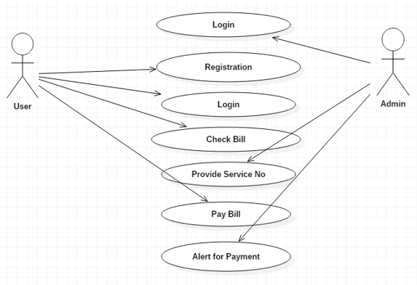
USE-CASE

Slide 7

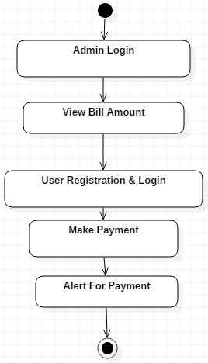
ACTIVITY DIAGRAM

Slide 8
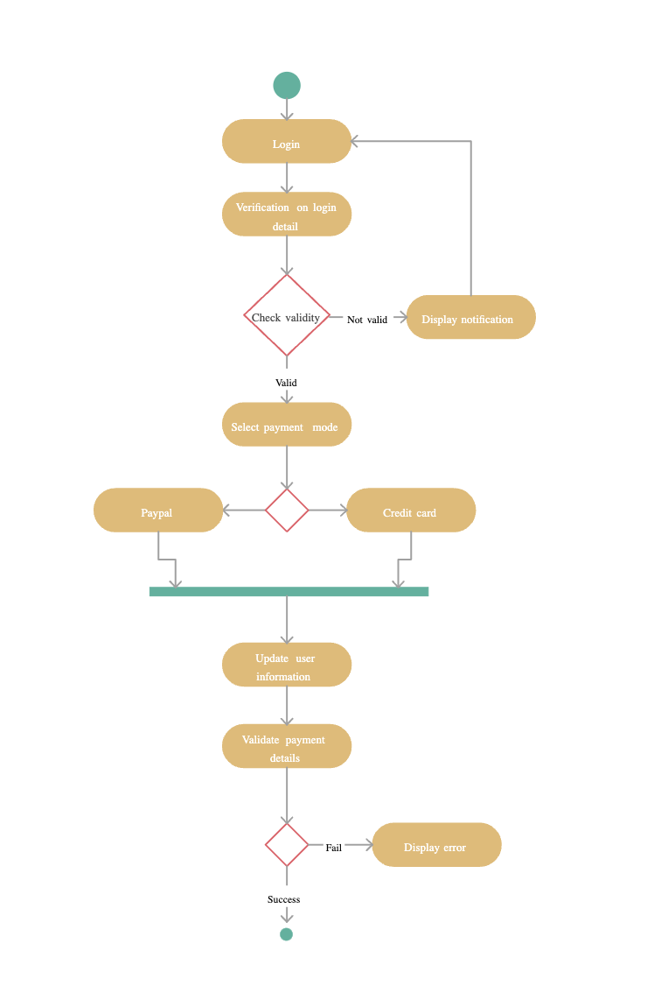

Slide 9
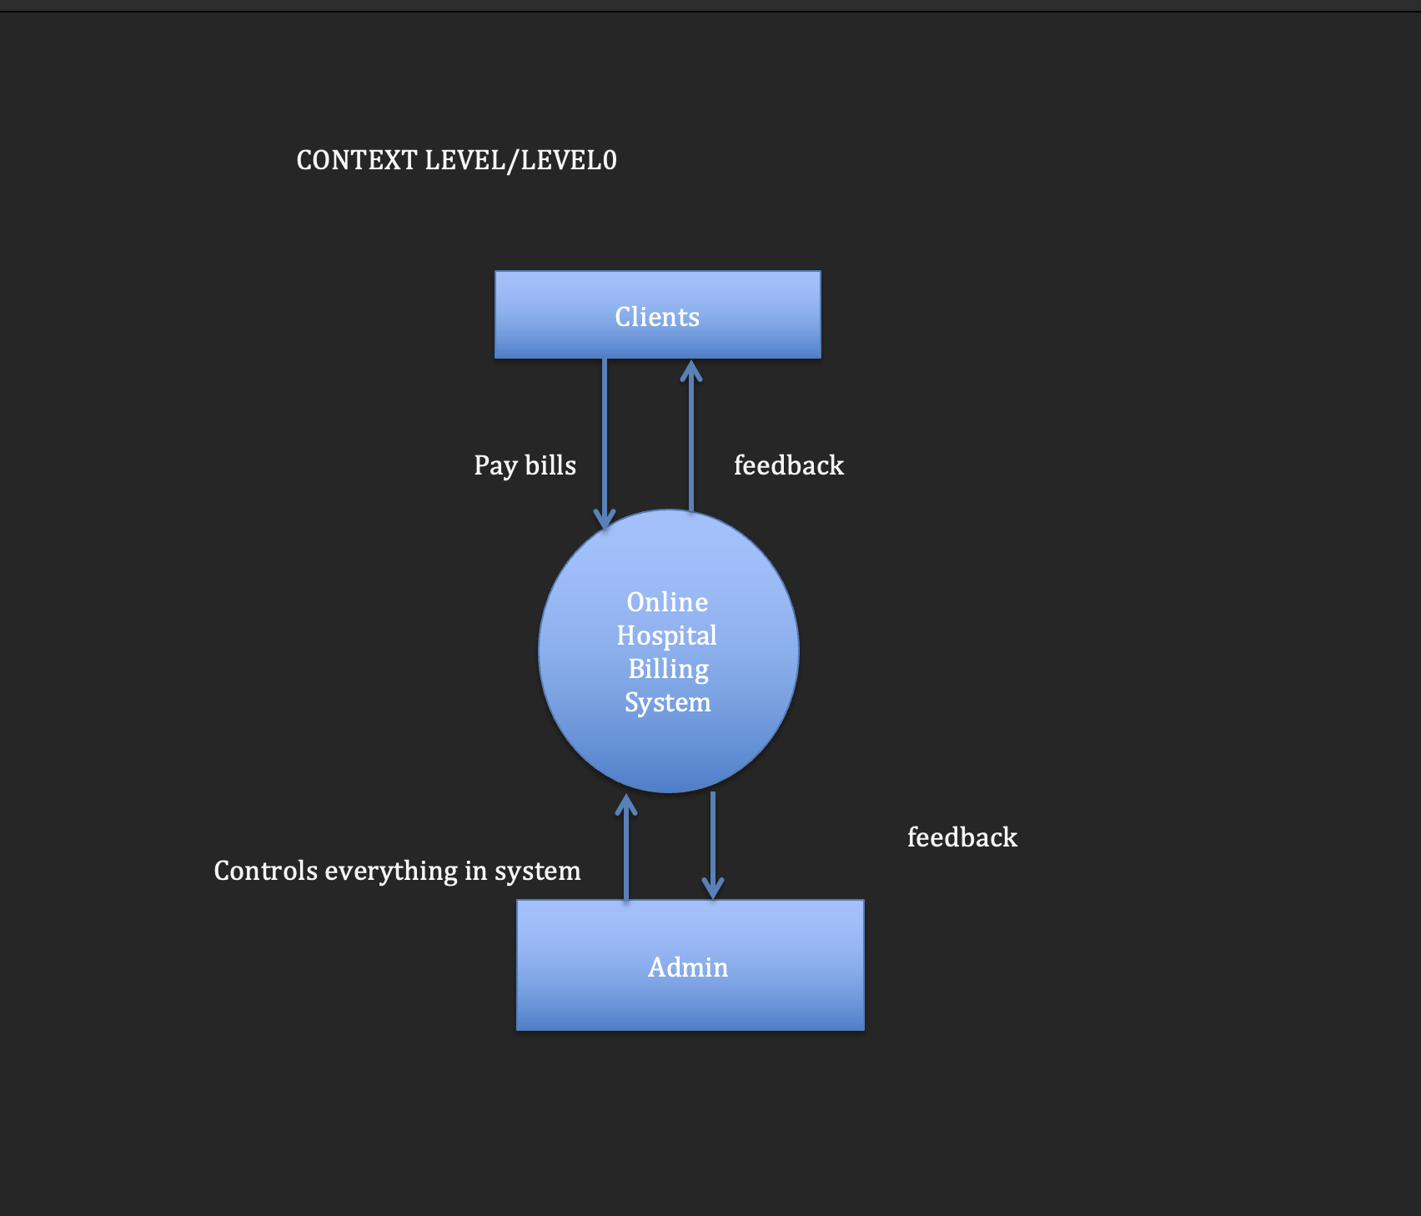
DATAFLOW DIAGRAM

Slide 10
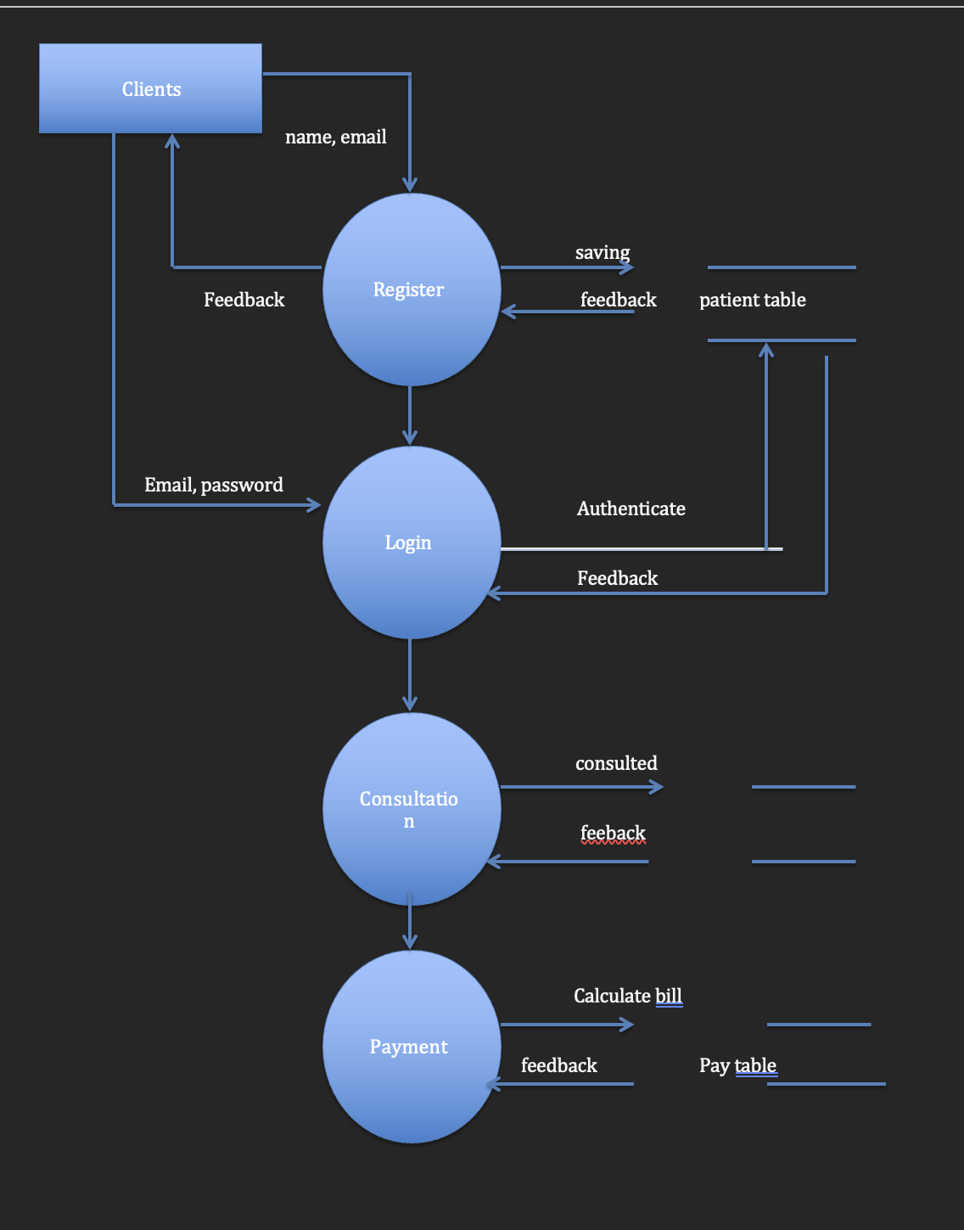
LEVEL 1

Slide 11
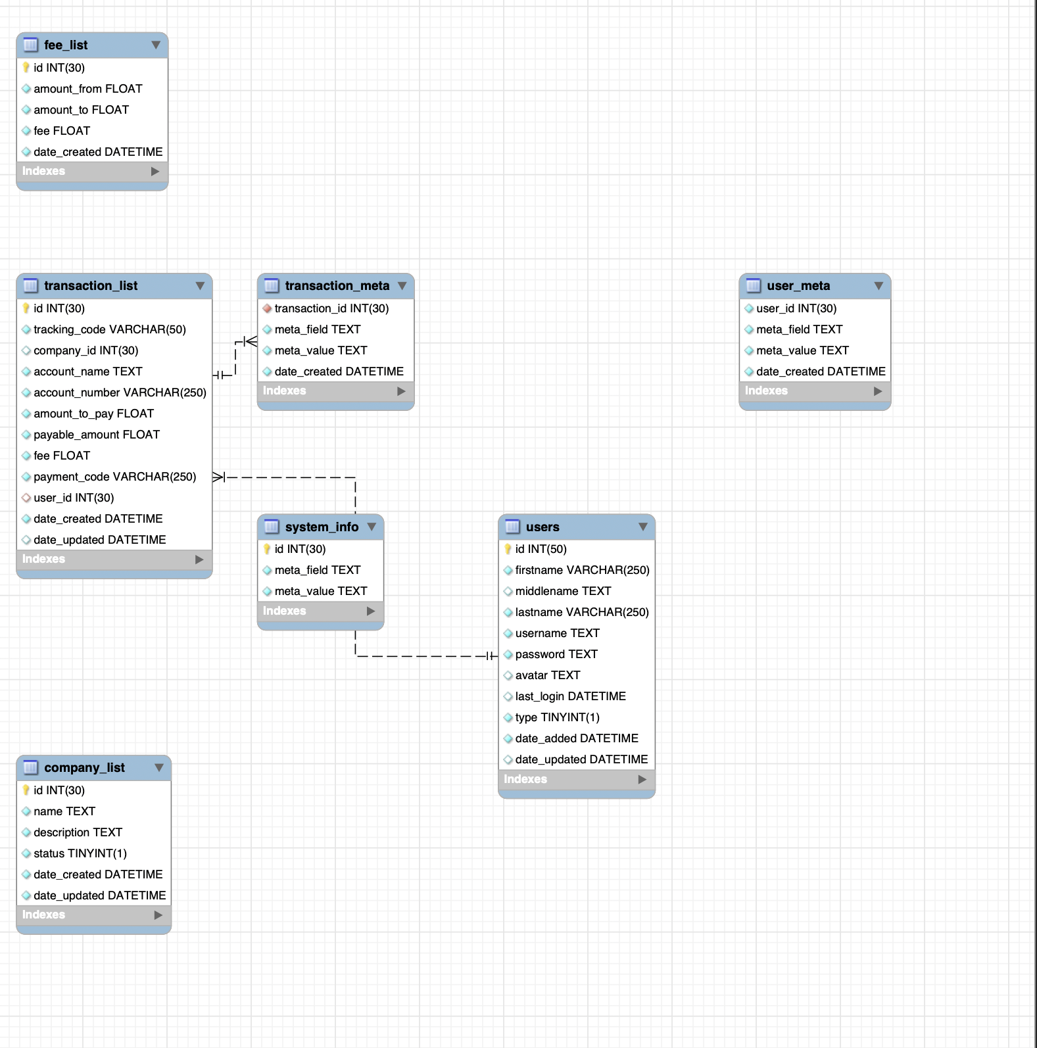
ER Diagram

Slide 12
FACT FINDING TECHNIQUES
Interview and observation were fact finding used.
An interview is a sort of contact in which one person seeks information from another.
Observation is the process of closely monitoring someone as he/she goes about with daily activities. Observation was used in addition to the interviews, because it is less biased fact finding technique.

Slide 13
TOOLS
Hypertext pre-processor (PHP)
Hypertext Mark-up Language (HTML)
3. XAMPP

Slide 14
FUNCTIONAL REQUIREMENTS
Req-no | Description | Type
Req-101 | The application must have a user interface. | Functional
Req-102 | Based on the login credentials, the system shall enable the user to log in or prompt an error. | Functional
Req-103 | The system shall allow the administrator to keep track of payments. | Functional
Req-104 | The system shall allow the clients to register and pay their bills. | Functional
Req-105 | The system shall allow the administrator to keep track of previous payments. | Functional

Slide 15
NON-FUNCTIONAL REQUIREMENTS
Req-no | Description | Type
Req-201 | The users should always be able to access the system. | Availability
Req-202 | To stop unauthorized access, the system needs to be secured. | Security
Req-203 | The system should be trustworthy in that it consistently completes its tasks correctly without giving rise to any unclear results. | Reliability
Req-204 | As the number of users grows, the system needs to be able to handle the workload. | Performance

Slide 16
TEST PLANS
Test-no | Functionality | Priority | Status
T-101 | The system should allow the administrator to log in with the required login details. | HIGH | Passed
T-102 | The system should allow the admin to view payments. | HIGH | Passed
T-103 | The system should allow the admin to edit client info. | HIGH | Passed
T-104 | The system should allow users to add new payments. | HIGH | Passed
T-105 | The system should allow the administrator to manage users. | HIGH | Passed

Slide 17
PROBLEMS ENCOUNTERED
1. Time constraints
2. Unavailability of resources to carry out research.
Experiencing difficulties when attempting to integrate the E-wallet feature into the website.

Slide 18
FUTURE ENHANCEMENT
Integrating an E-wallet feature into my website.

Slide 19
RESULTS AND CONCLUSION
The system proved to be reliable sustainable as it’s outcomes will be graded as very good. This system will be of help, not only to the patients, but to the entire Nigerian Navy. The OHBS will also serve as a model for Nigerian Navy to store transactions by clients in centralized cloud storage instead of stacking it in a store for easy access.

Slide 20
THANK YOU

